Slide 1
Christians & Sheffield Schools
The vision of CaSS is to encourage, resource and enable Christians to serve schools. These prayer cards were produced to celebrate CaSS’ 35th anniversary.
www.cass-su.org.uk

Slide 2
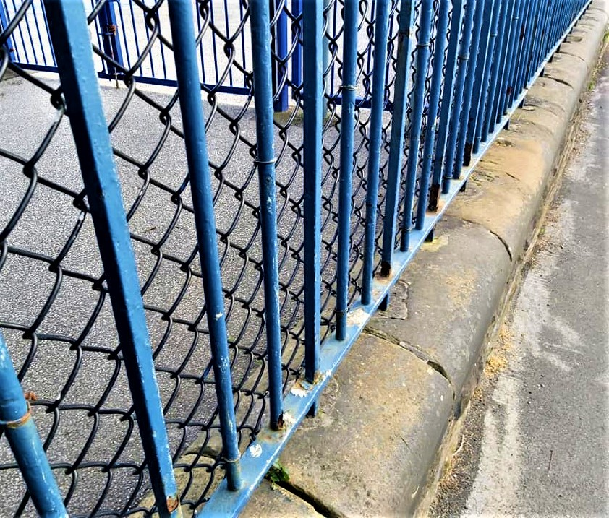
head teachers

Slide 3
teachers

Slide 4
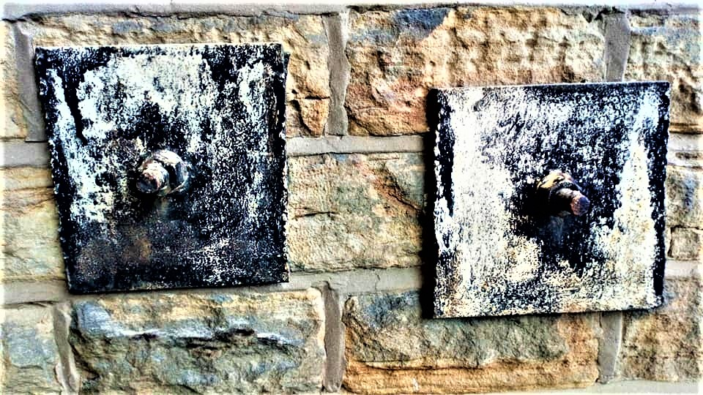
support staff

Slide 5
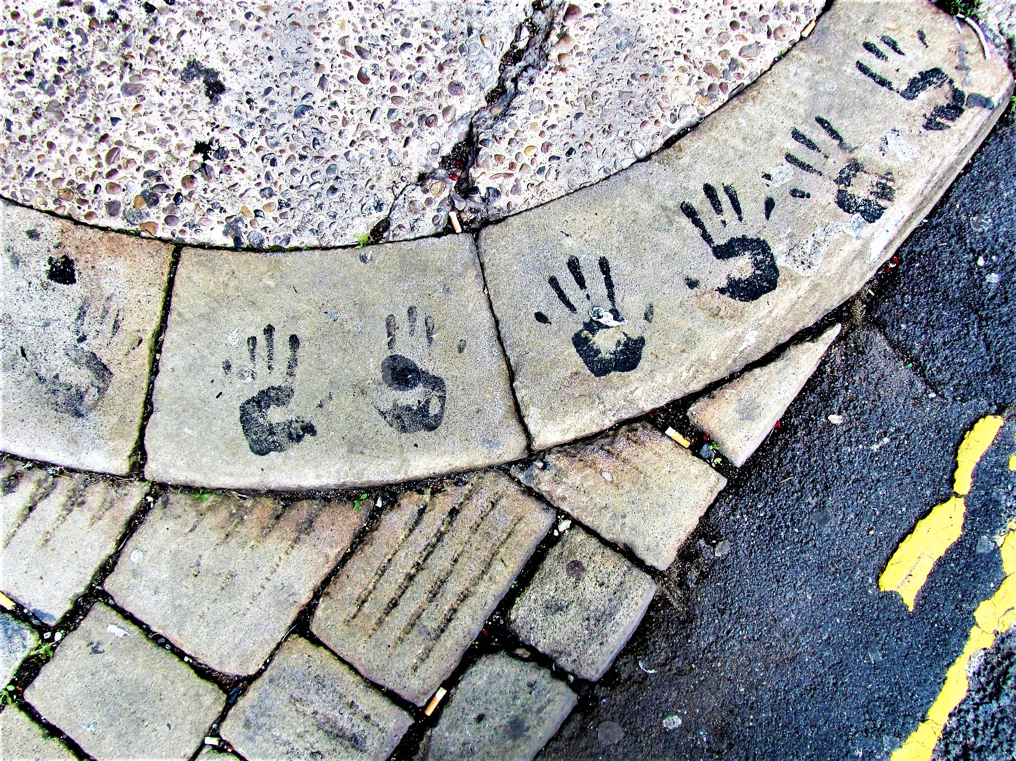
pupils

Slide 6
governors

Slide 7
transition

Slide 8
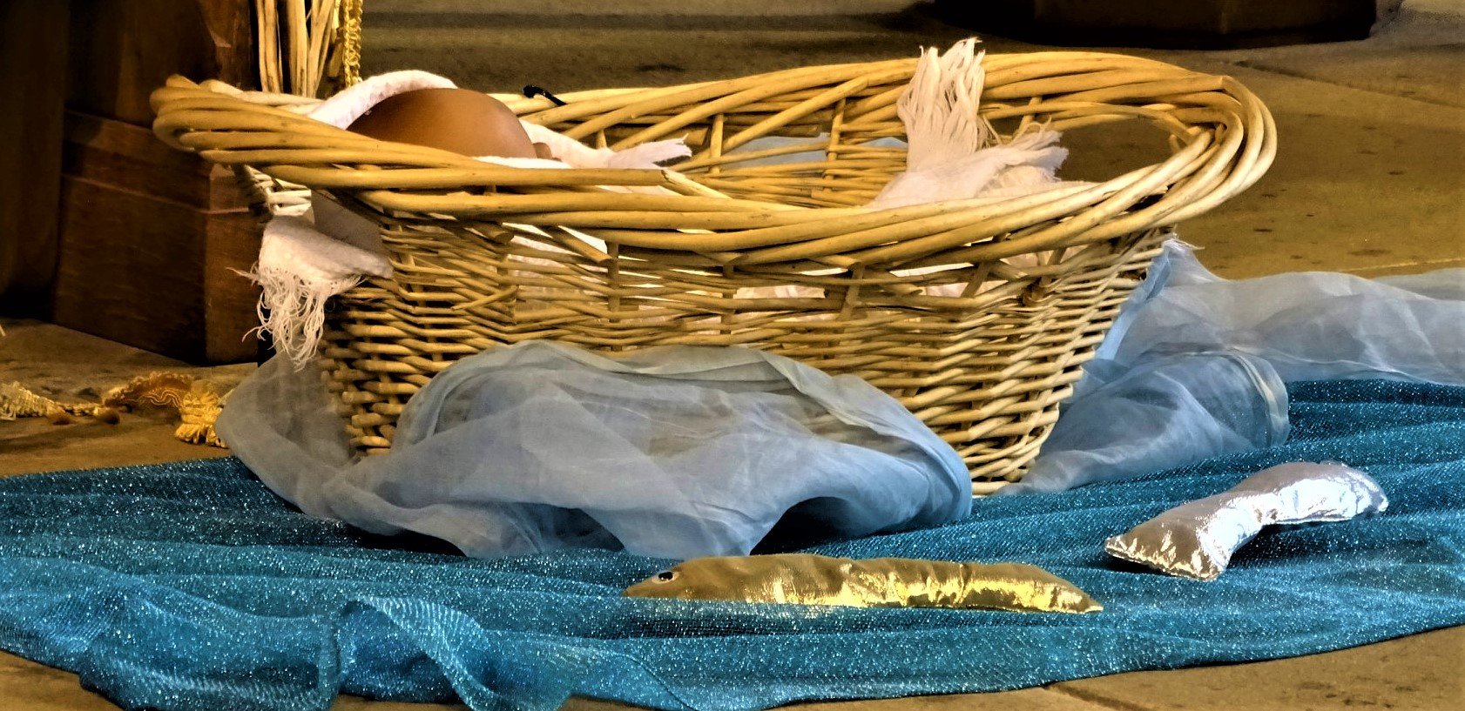
collective worship

Slide 9
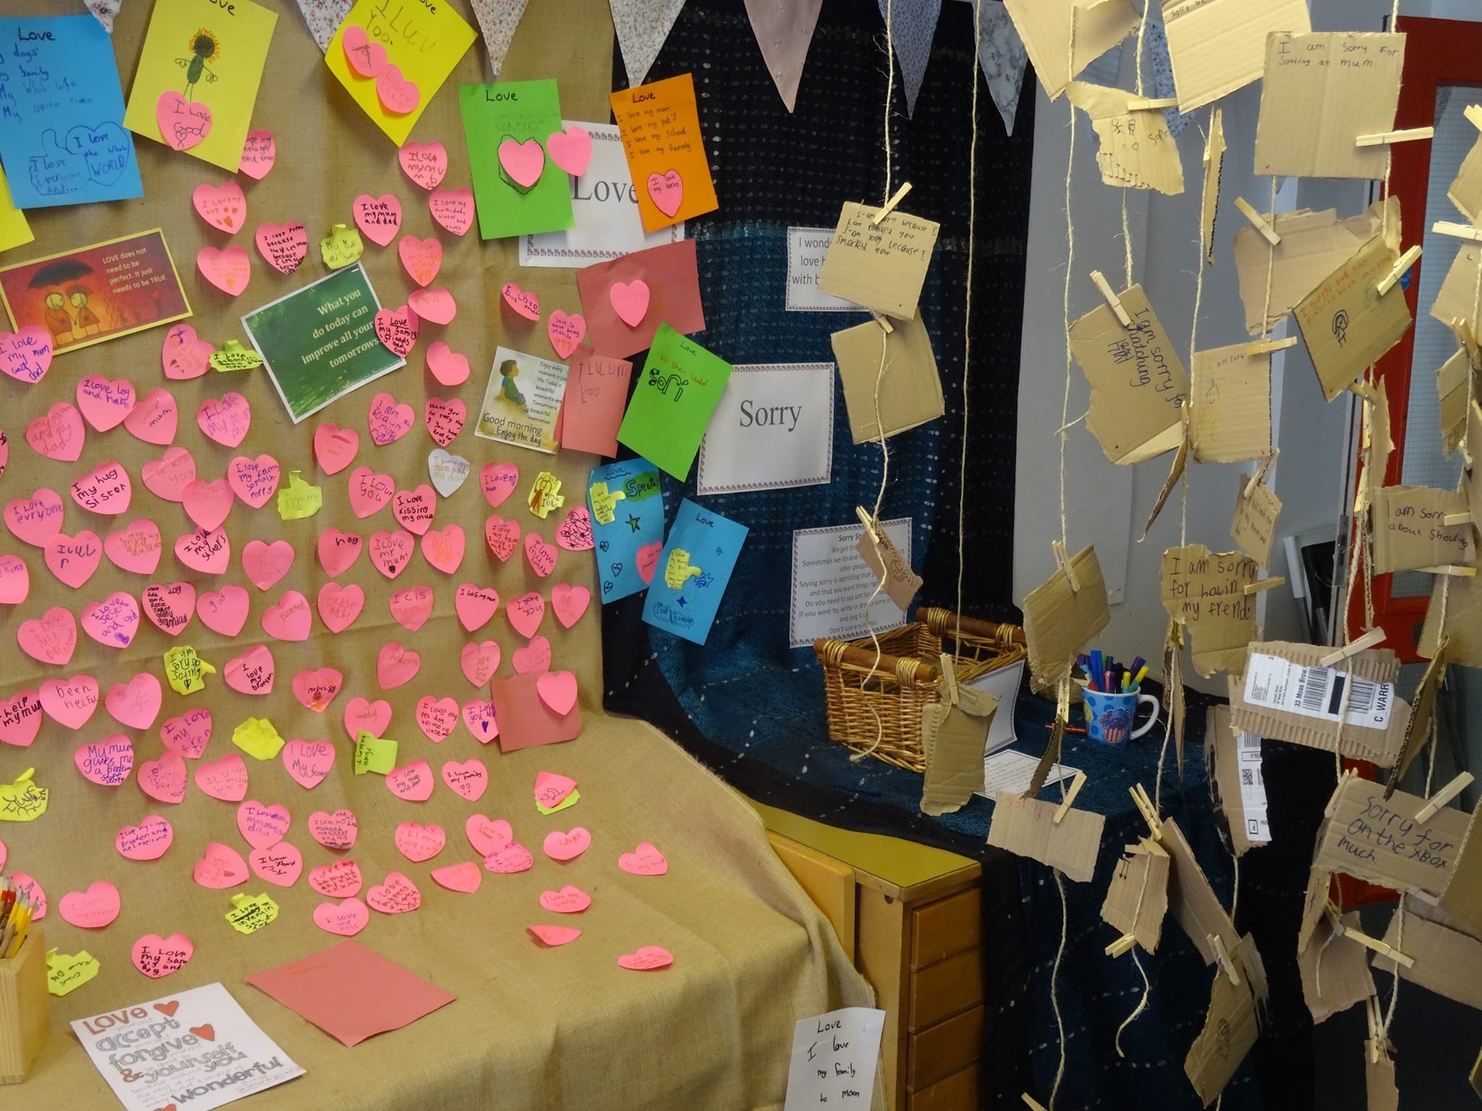
prayer

Slide 10
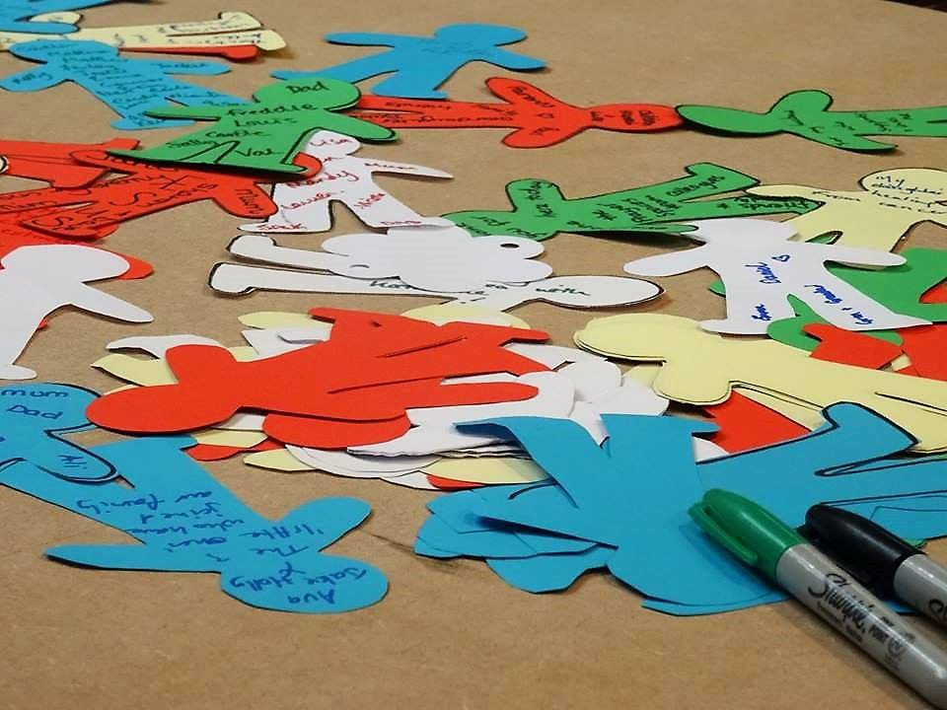
christian unions

Slide 11
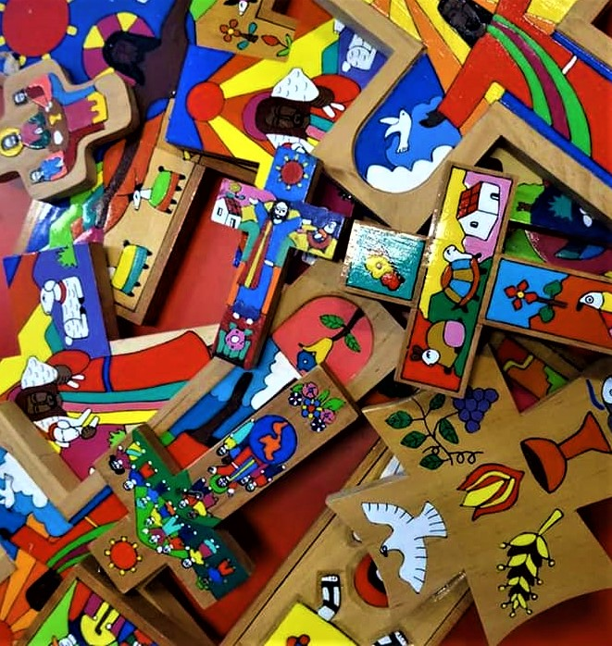
religious education

Slide 12
loss

Slide 13
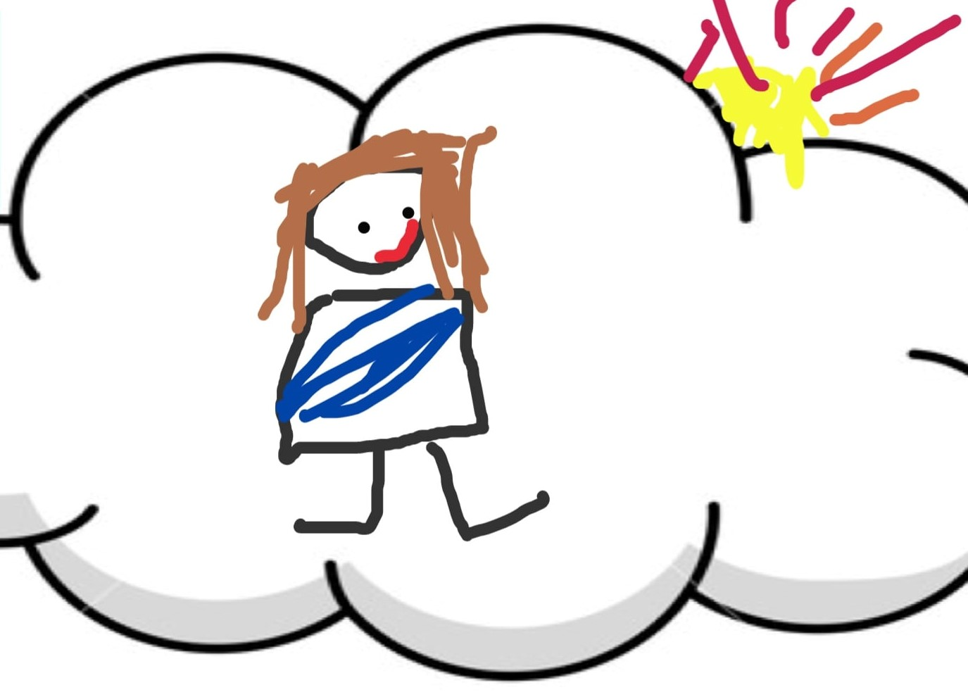
chaplains

Slide 14
values

Slide 15
opportunities

Slide 16
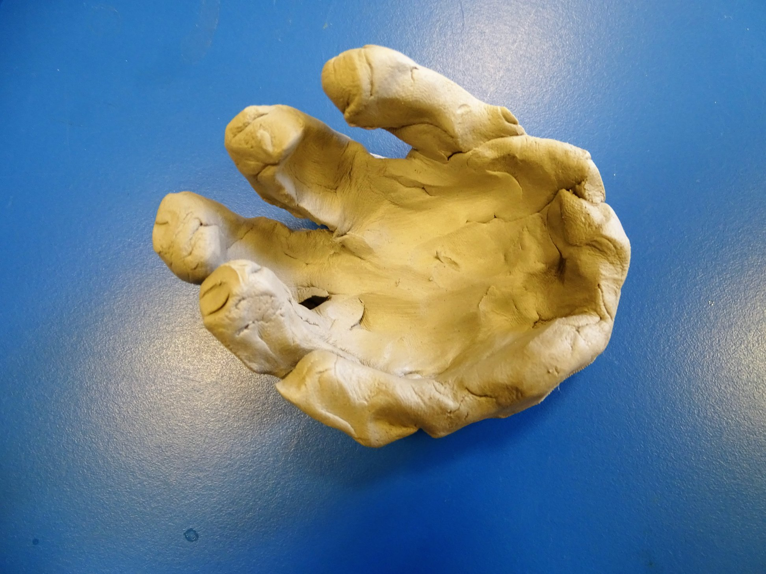
additional needs

Slide 17
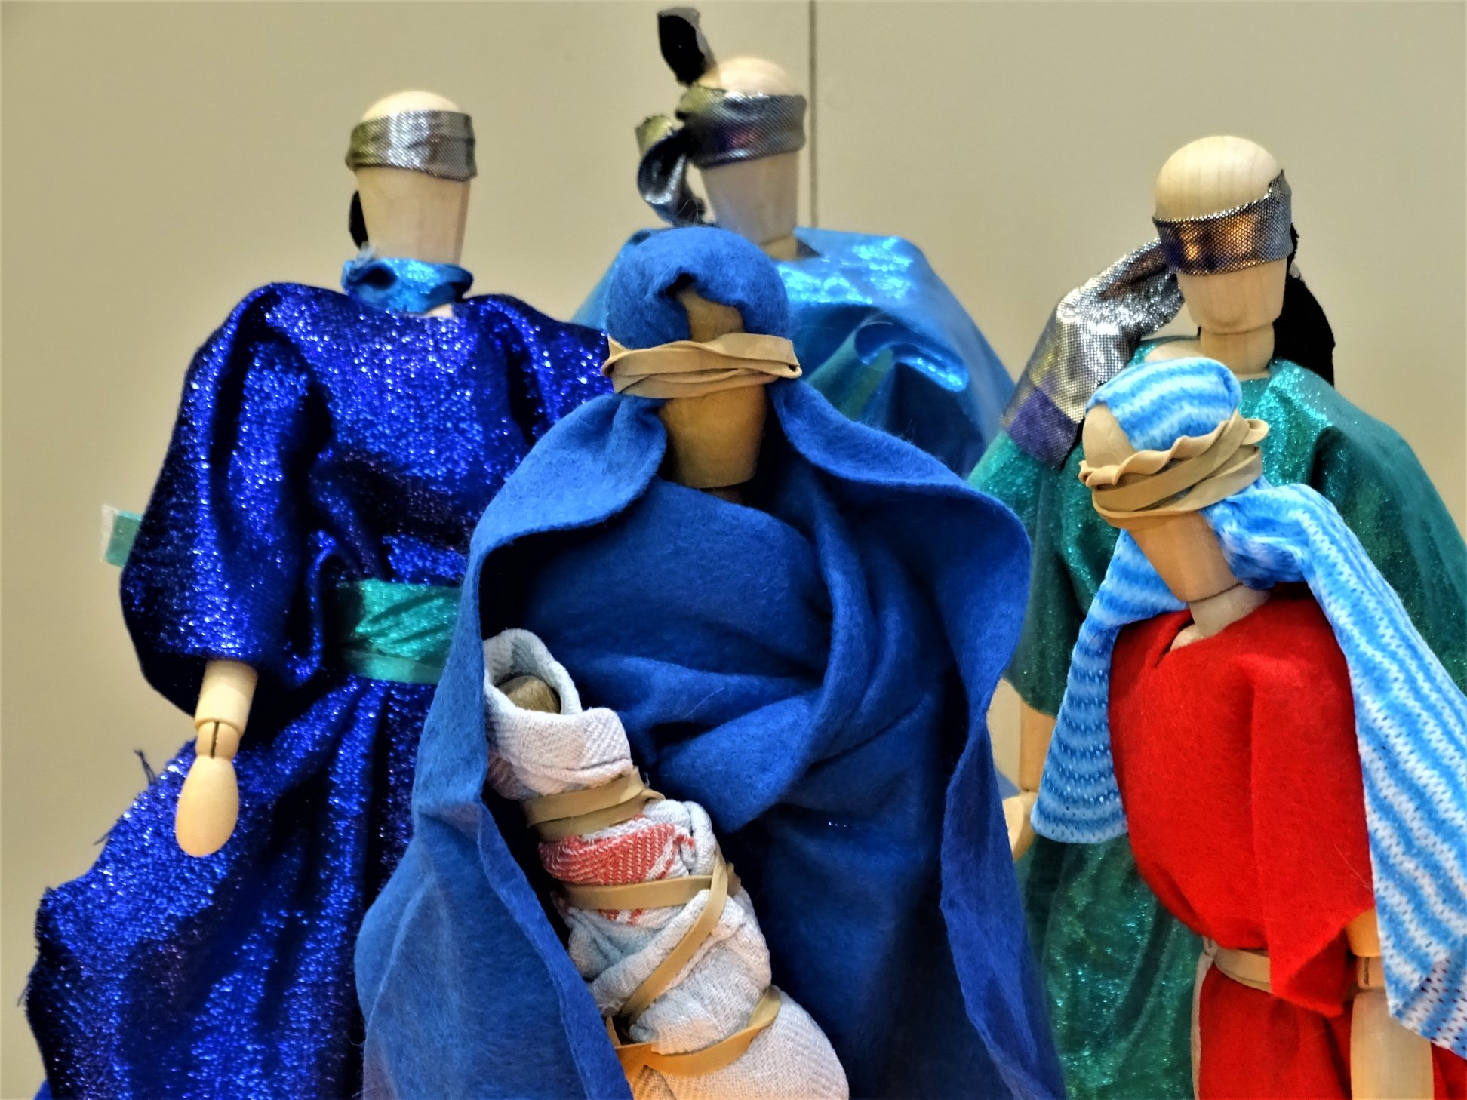
festivals

Slide 18
lunch time

Slide 19
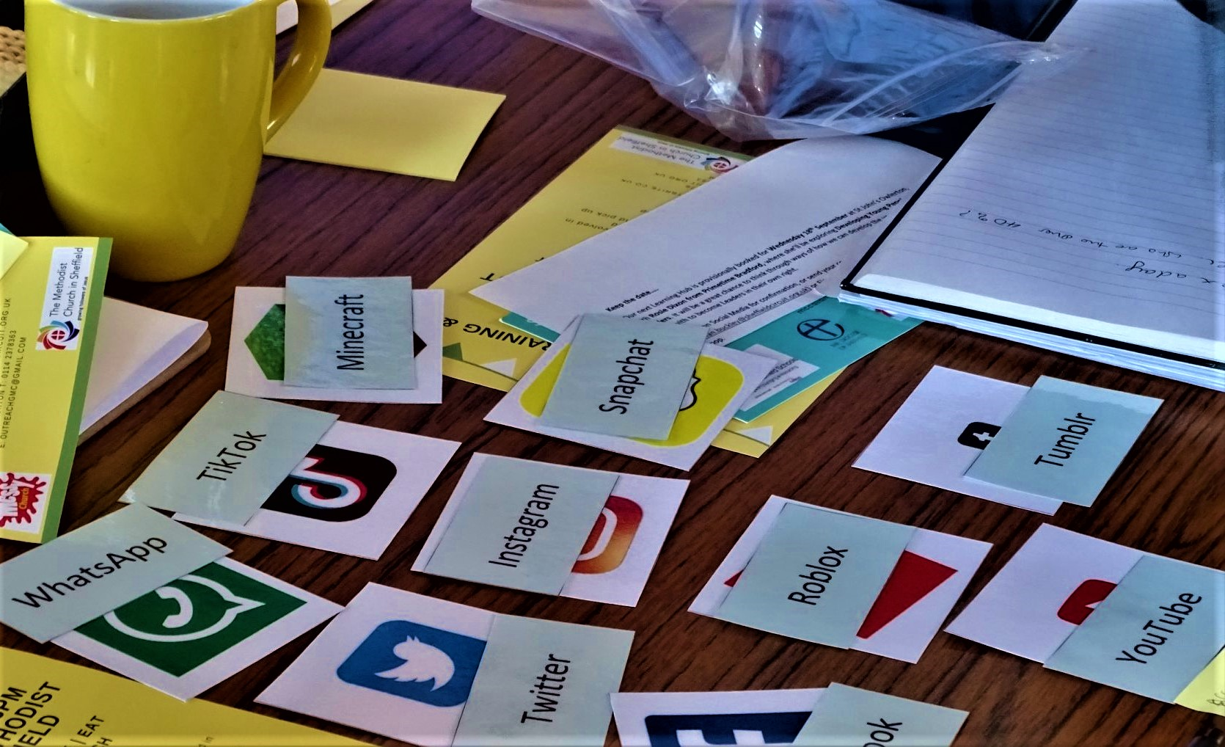
internet

Slide 20
families

Slide 21
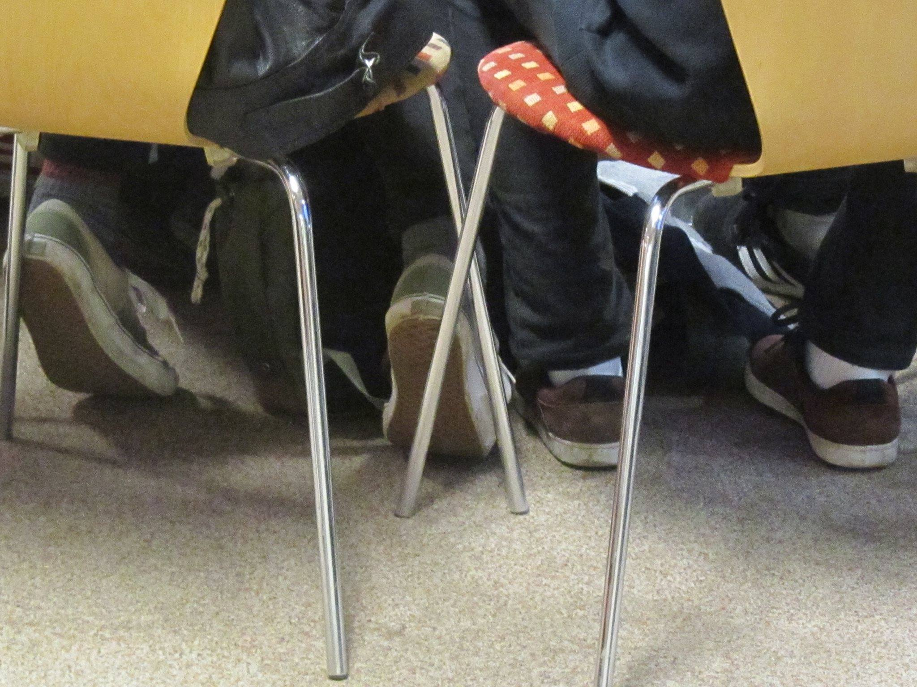
learning

Slide 22
thanksgiving

Slide 23
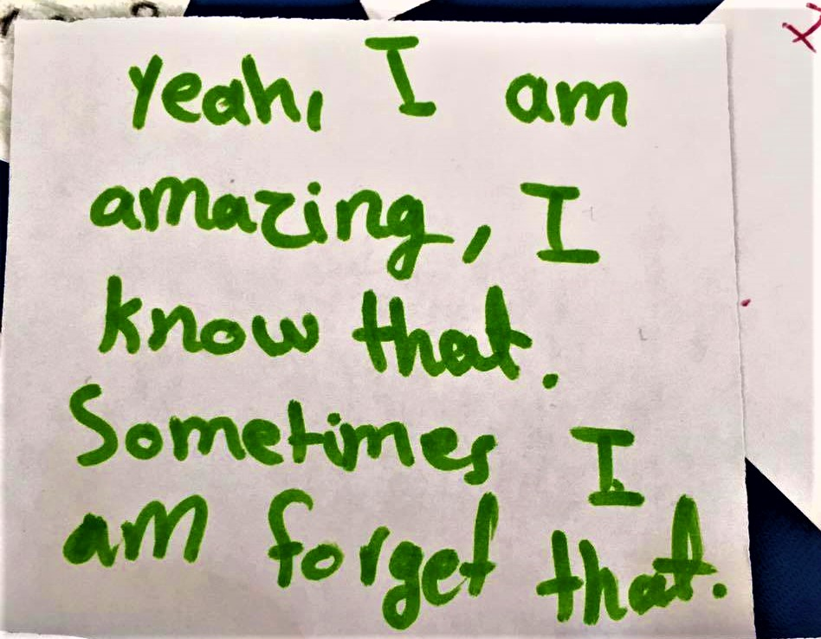
mentoring

Slide 24
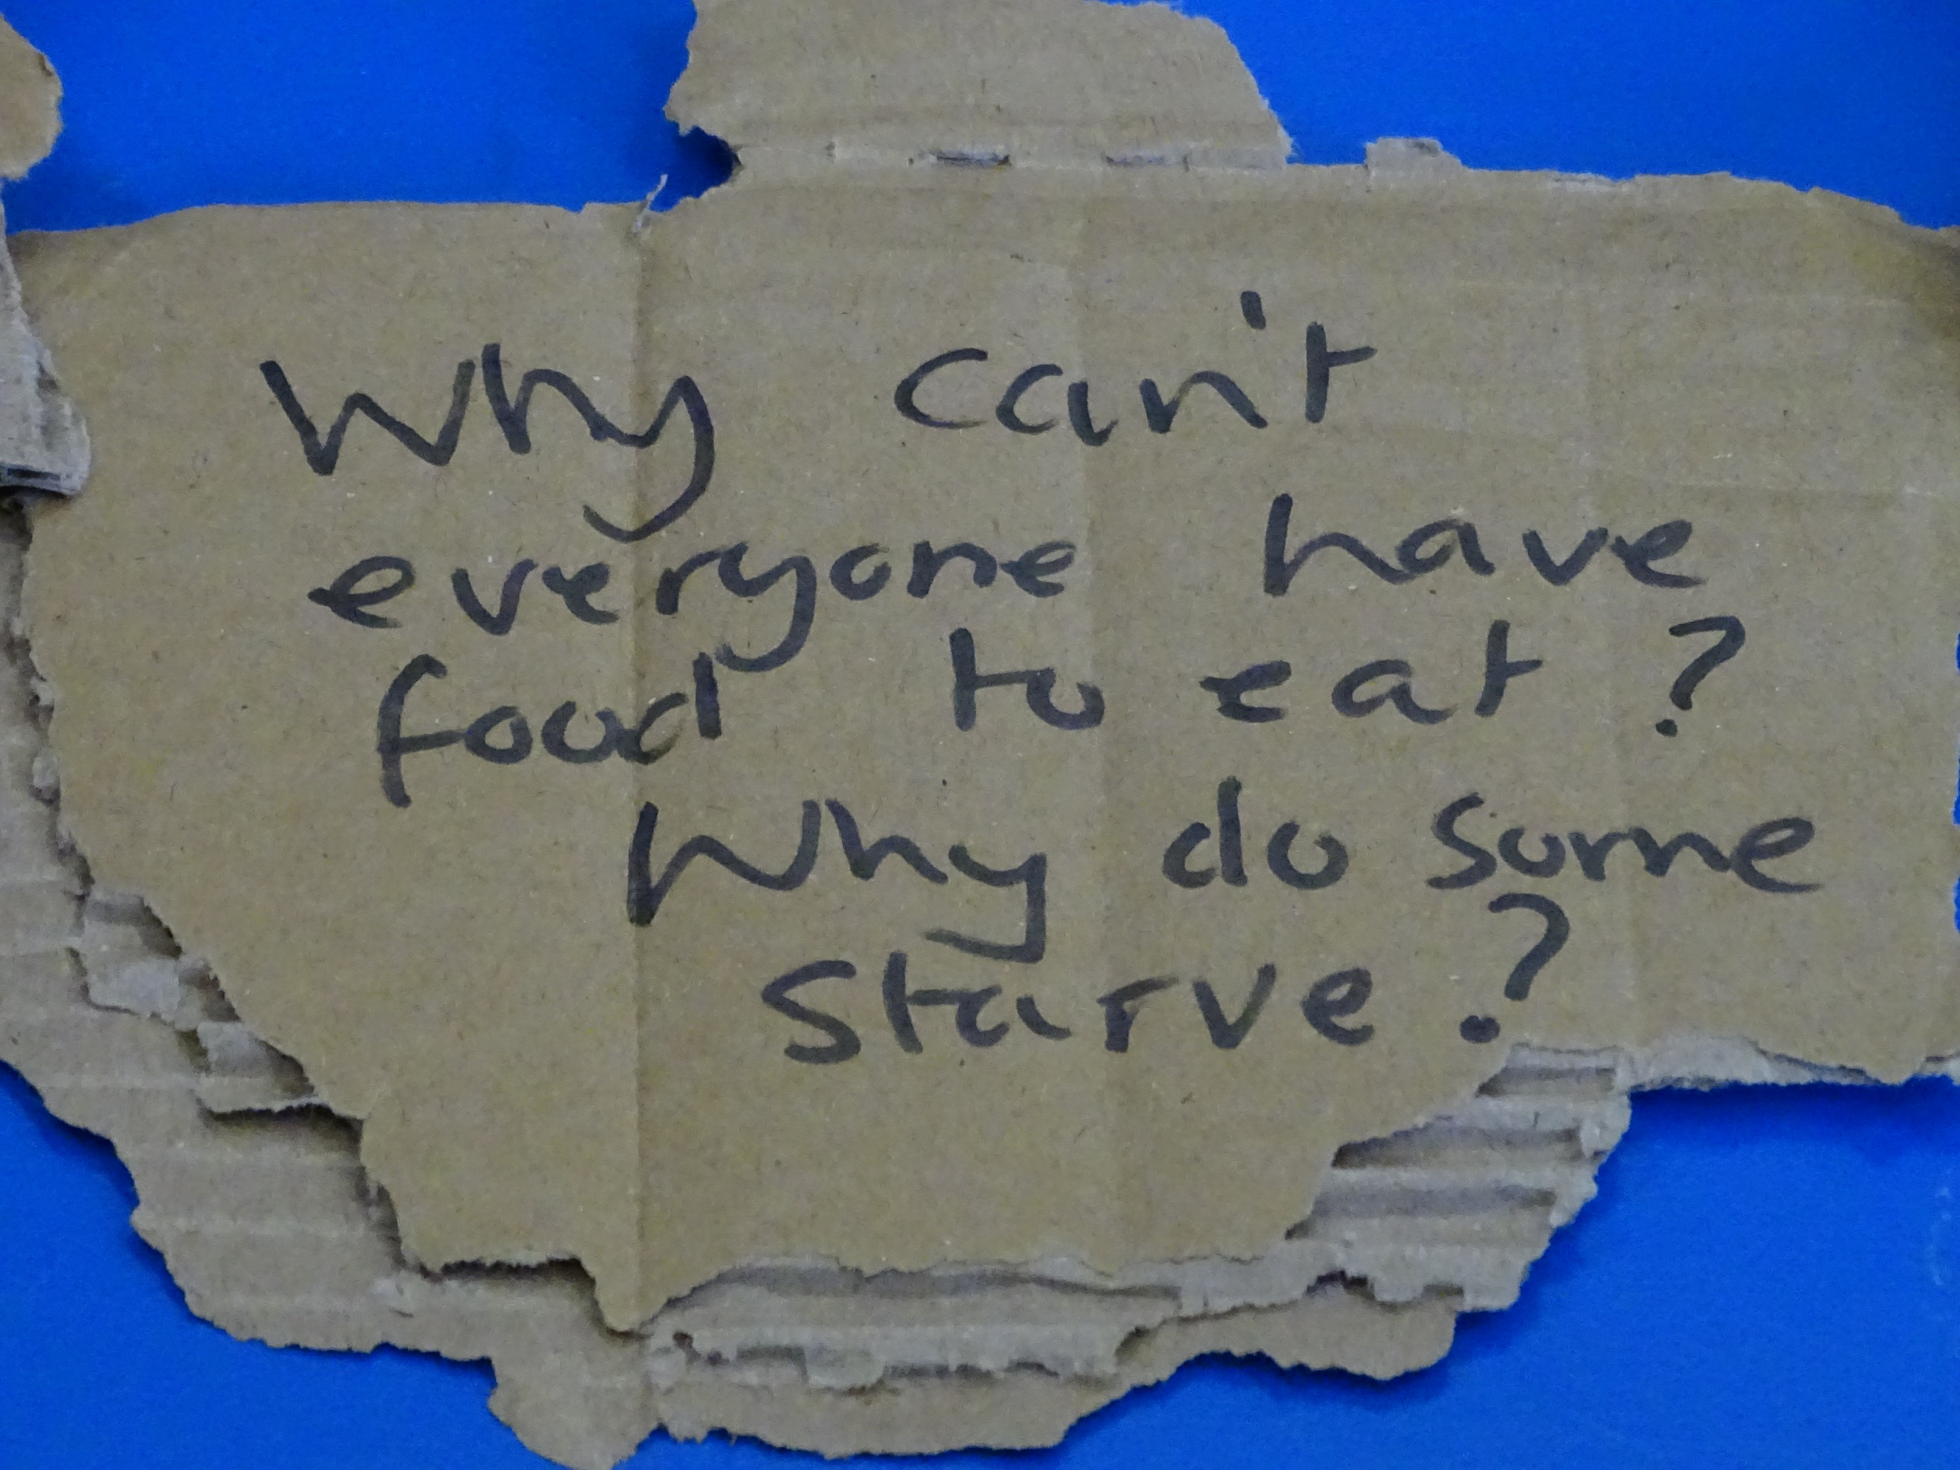
poverty

Slide 25
safety

Slide 26
rest

Slide 27
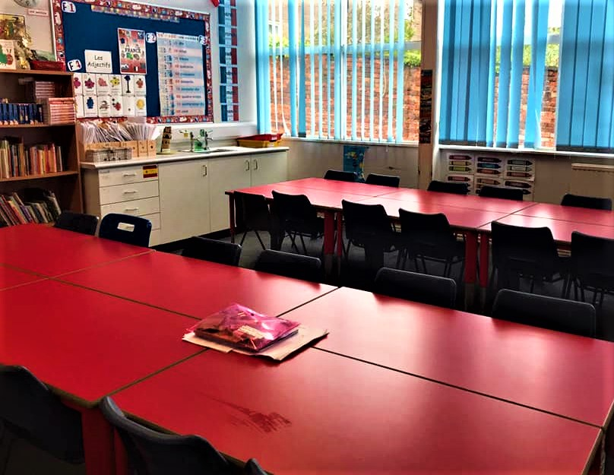
classrooms

Slide 28
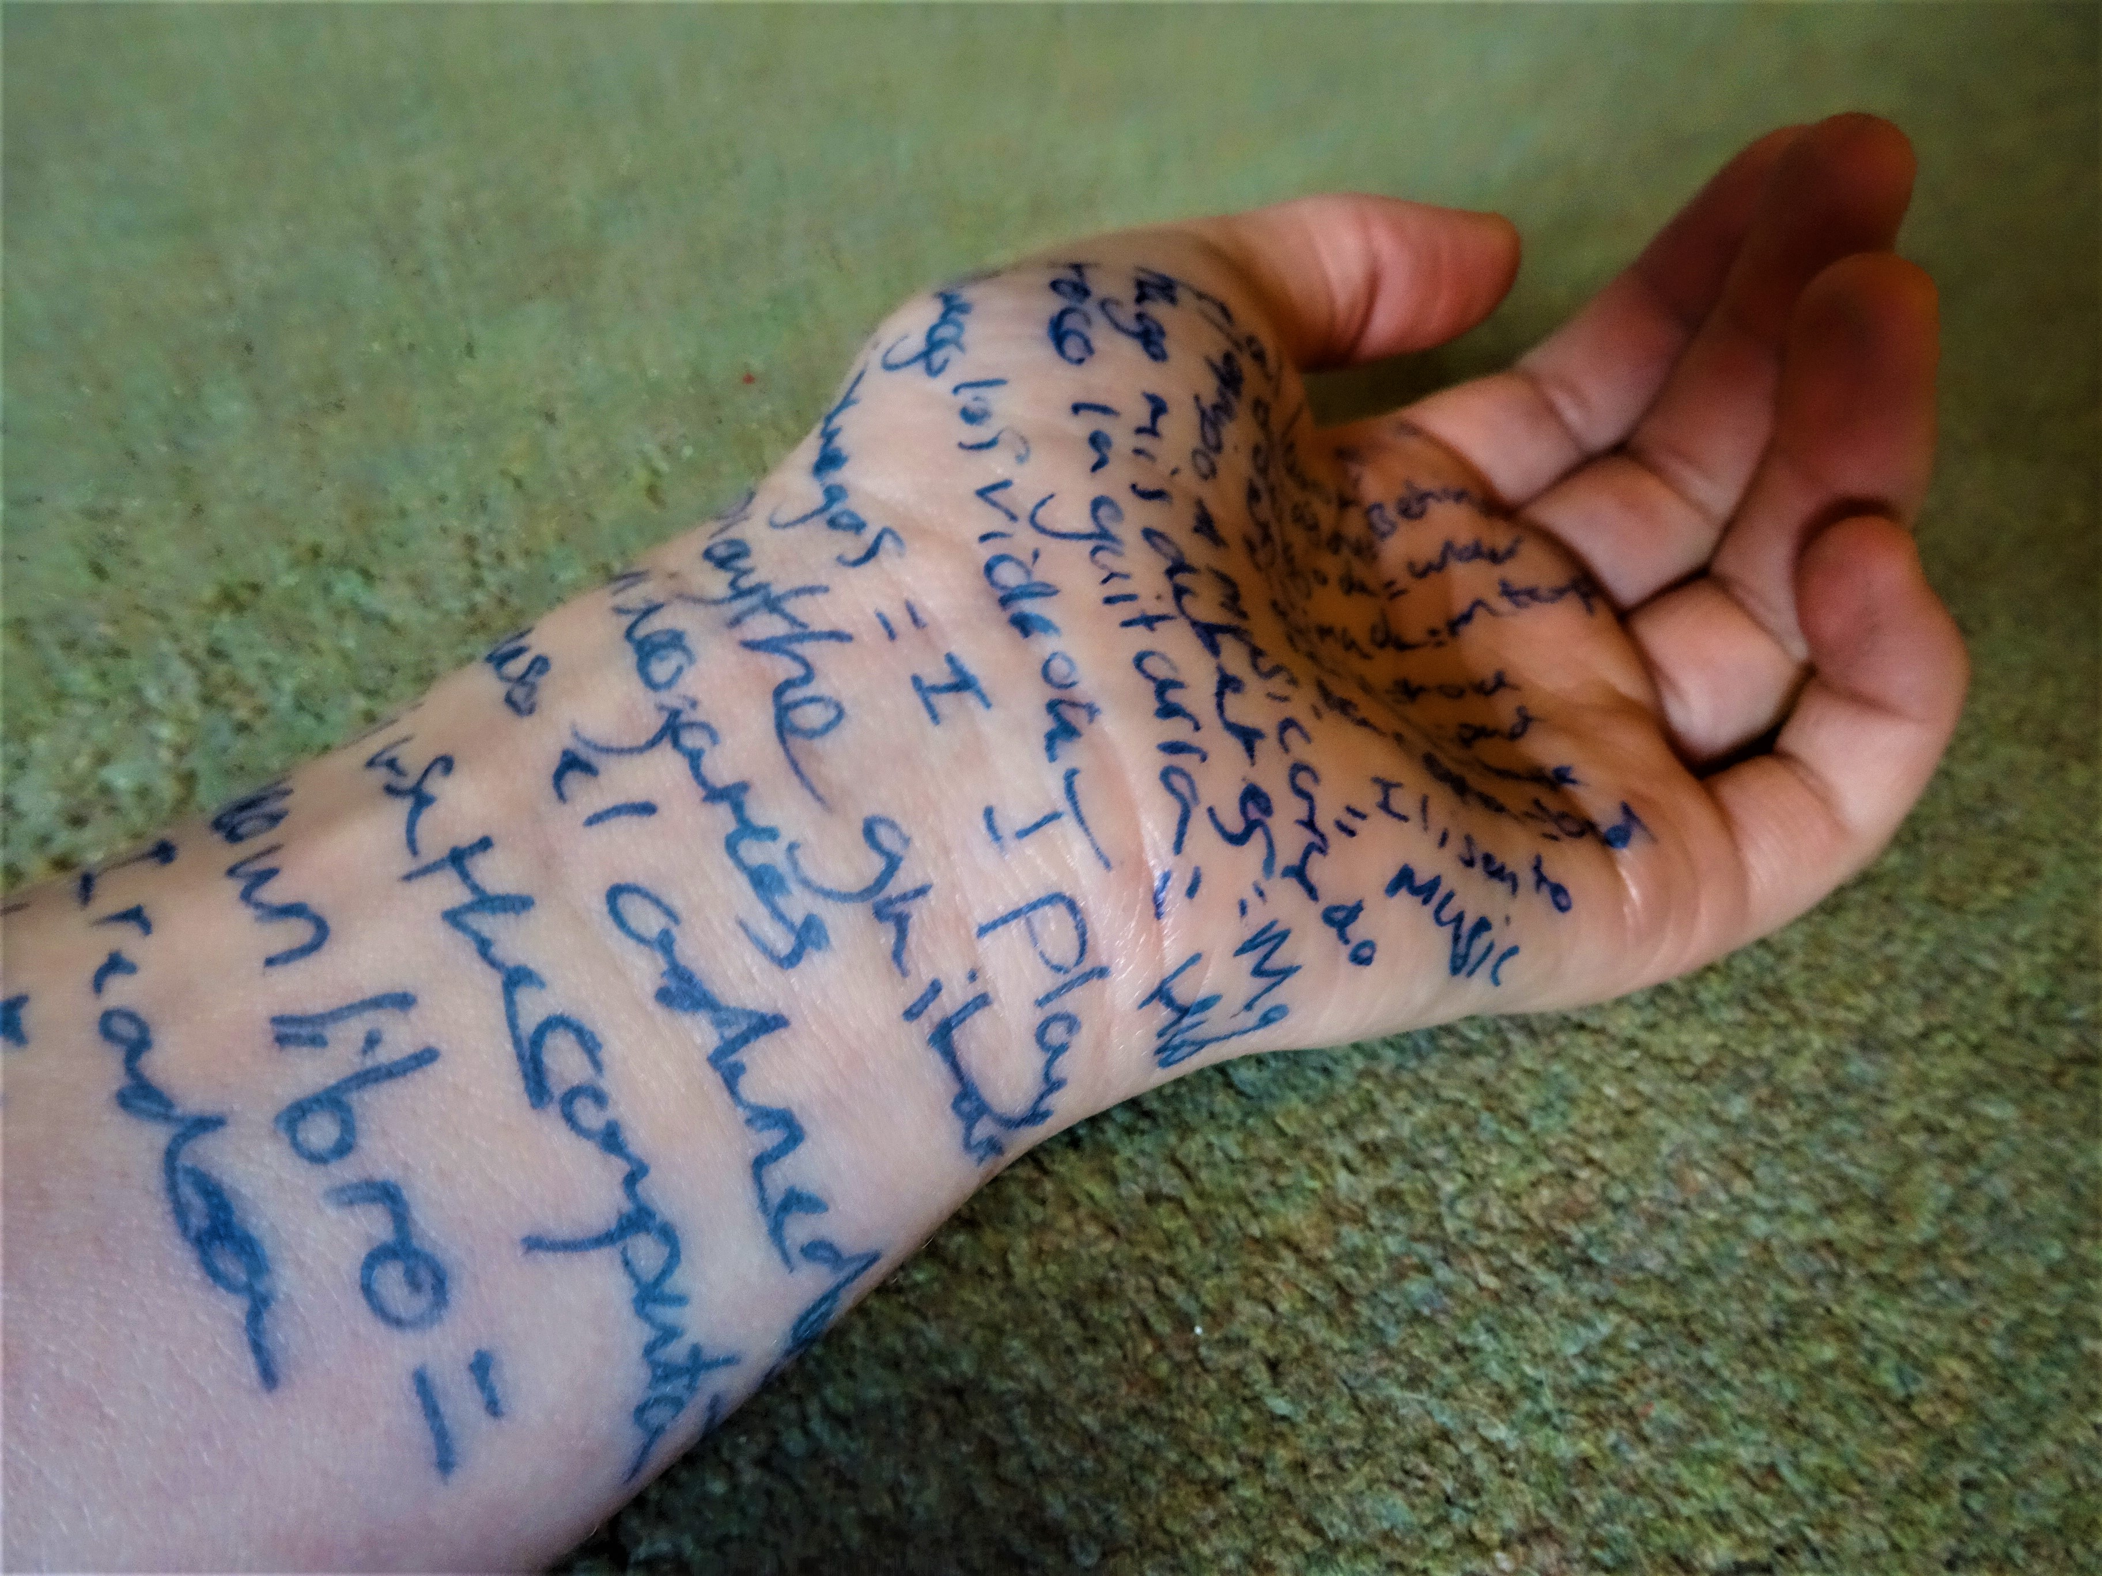
harm

Slide 29
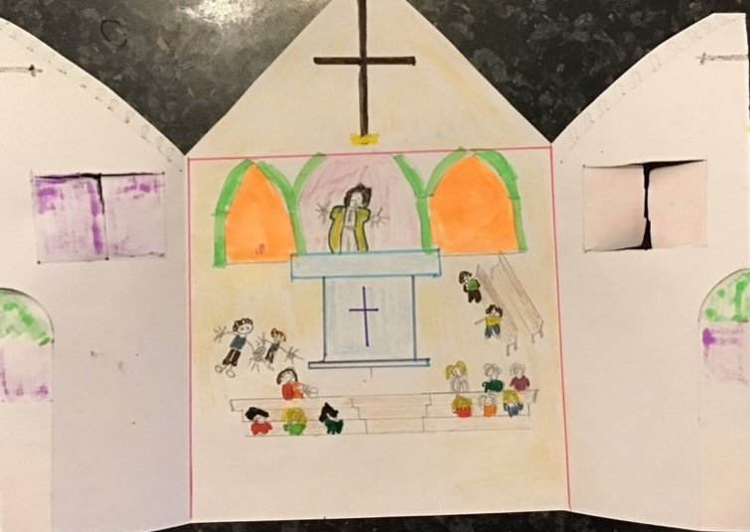
church visits

Slide 30
crossing patrols

Slide 31
listening

Slide 32
encouragement

Slide 33
community

Slide 34
mental health

Slide 35
friendships

Slide 36
faith

Slide 37
The Word became flesh and blood, and moved into the neighbourhood. John 1:14 (The Message)

